Slide 1
Chapter 2
End-to-end machine learning project

Slide 2
Machine learning checklist (project lifecycle)
Frame the problem and look at the big picture
“Building a model is probably not the goal”. How does the client expect to USE AND BENEFIT from the model?
Get the data
Explore the data to gain insights
Prepare the data to better expose the underlying data patterns to Machine Learning Algorithms
Explore many different models and short-list the best ones
Fine-tune you models and combine them into a great solution
Present your solution
Launch, monitor, and maintain your system

Slide 3
“Some Algorithms” overview

Slide 4
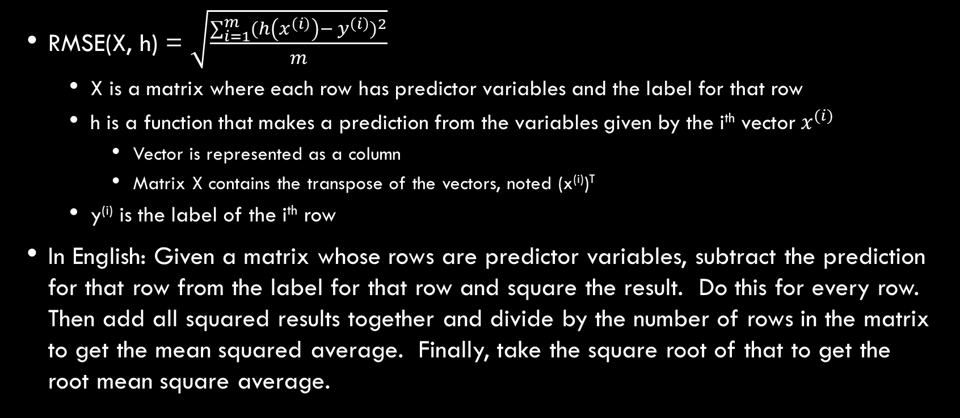
Performance measures
RMSE(X, h) = $\sqrt{\frac{\sum_{i=1}^{m}{{(h\left(x^{\left(i\right)}\right)− y^{\left(i\right)})}^{2}}}{m}}$
X is a matrix where each row has predictor variables and the label for that row
h is a function that makes a prediction from the variables given by the i^{th} vector${ x}^{(i)}$
Vector is represented as a column
Matrix X contains the transpose of the vectors, noted (x^{(i)})^{T}
y^{(i)} is the label of the i^{th} row
In English: Given a matrix whose rows are predictor variables, subtract the prediction for that row from the label for that row and square the result. Do this for every row. Then add all squared results together and divide by the number of rows in the matrix to get the mean squared average. Finally, take the square root of that to get the root mean square average.

Slide 5
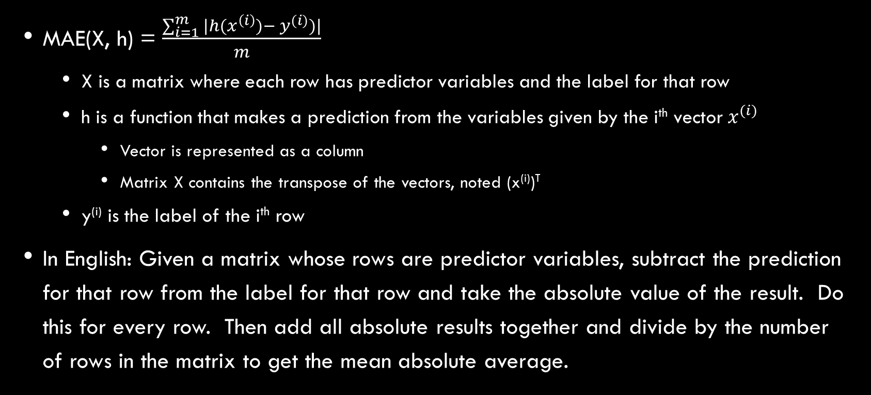
Performance measures
MAE(X, h) = $\frac{\sum_{i=1}^{m}{|h(x^{\left(i\right)})− y^{(i)})|}}{m}$
X is a matrix where each row has predictor variables and the label for that row
h is a function that makes a prediction from the variables given by the i^{th} vector${ x}^{(i)}$
Vector is represented as a column
Matrix X contains the transpose of the vectors, noted (x^{(i)})^{T}
y^{(i)} is the label of the i^{th} row
In English: Given a matrix whose rows are predictor variables, subtract the prediction for that row from the label for that row and take the absolute value of the result. Do this for every row. Then add all absolute results together and divide by the number of rows in the matrix to get the mean absolute average.

Slide 6
Performance measures - comparison
Both RMSE and MAE measure the distance between the vector of predictions and the vector of target values
RMSE
“The notion of distance you are familiar with” (Euclidean Norm)
Affected more by outliers
Performs very well and is generally preferred where outliers are rare, as in bell shaped curves
MAE
Less affected by outliers

Slide 7
Terminology review
Signal – A piece of information fed to an ML algorithm
Pipeline – A sequence of data processing components
Label – Expected output
Multiple regression problem – The system will use multiple features to make a prediction
Univariate regression problem – Trying to predict a single value for each data set
Multivariate regression problem – Trying to predict multiple values for each data set

Slide 8
Terminology review
Norm – measure of distance between two vectors
Euclidean Norm (see RMSE) – “The notion of distance you are familiar with”
Manhattan Norm (see MAE) – “The distance between two points in a city if you have can only travel along orthogonal blocks”
Standard deviation – “measures how dispersed values are”
Square root of the variance
Variance – Average of the squared deviation from the mean
Percentiles – “Indicates the value below which a given percentage of observations in a group of observations falls”

Slide 9
Terminology review
Quartile – 25th, 50th, 75th percentiles

Slide 10
Additional information
Microsoft data science lifecyle: https://docs.microsoft.com/en-us/azure/machine-learning/team-data-science-process/overview
RMSE vs Standard Deviation: https://stats.stackexchange.com/questions/264906/rmse-vs-standard-deviation-in-population

